Slide 1
Notre Dame Army ROTC Simultaneous Membership Program
An introduction for current or prospective members of our National Guard/Army Reserves interested in participating in both organizations

Slide 2
Table of Contents
Qualifications
What is ROTC: Review
What is the SMP?
SMP Benefits/Scholarships
Prior service SMP ROTC path
3 Non-prior service SMP ROTC paths
National Guard after College
Mission of the National Guard

Slide 3
Qualifications
Notre Dame ROTC SMP Qualifications include:
US Citizen; no dual citizenship
Under 31 years for entire commissioning year
2.0 cumulative GPA (minimum)
Academic sophomore (minimum)
Pass APFT; meet height/weight standards
Medically qualified
Full-time student status
Waivers for dependents(spouses and children) and civil convictions

Slide 4
Review: What is Army ROTC?
Reserve Officers’ Training Corps is:
An elective curriculum you take along with your required college classes
A practical and hands on training experience
A challenging yet fun experience for all cadets
A chance for cadets to lead peers and discover their strengths
One of several ways to become a commissioned officer

Slide 5
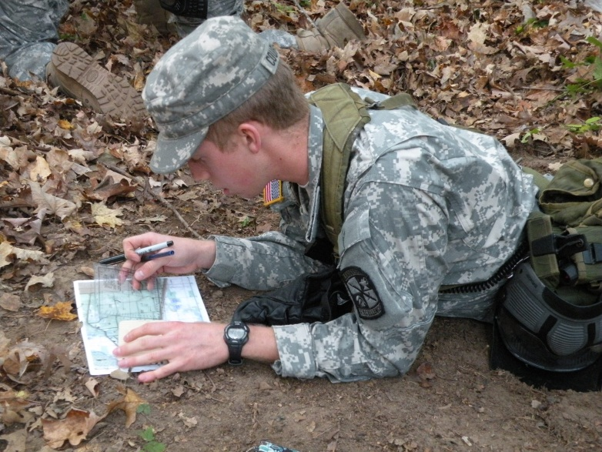
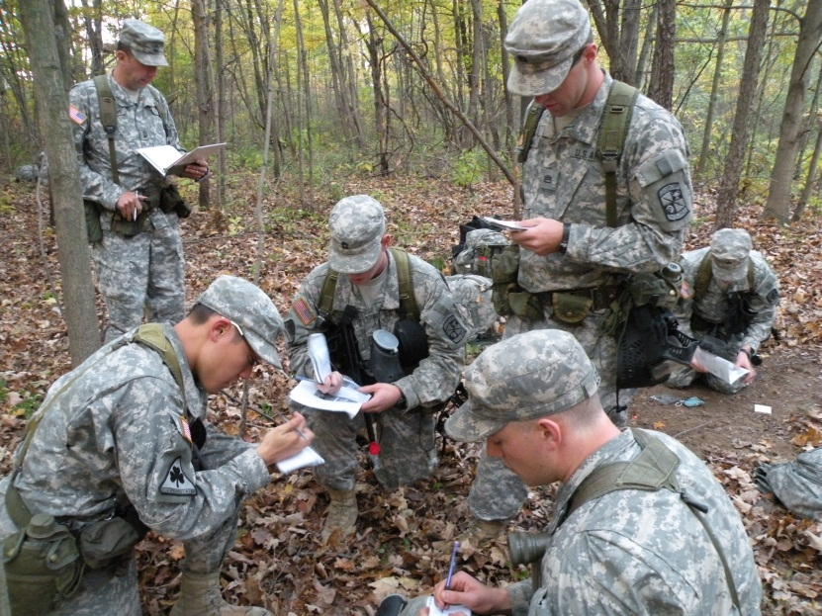
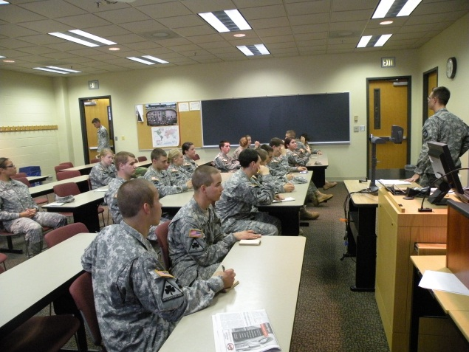
Cadet Life
Freshman Orientation
Classes
Leadership Lab
Physical Training
Field Training Exercises
ROTC Clubs
Army Schools
Strong Friendships that will last a lifetime.

Slide 6
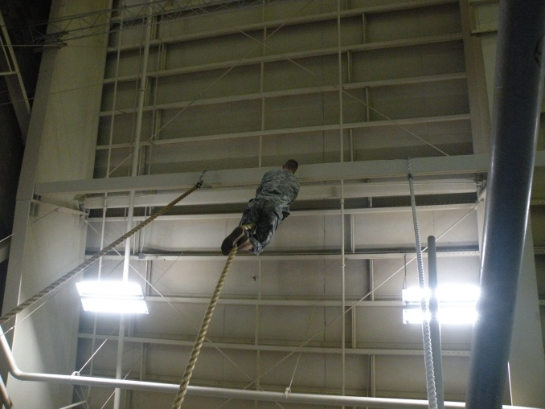
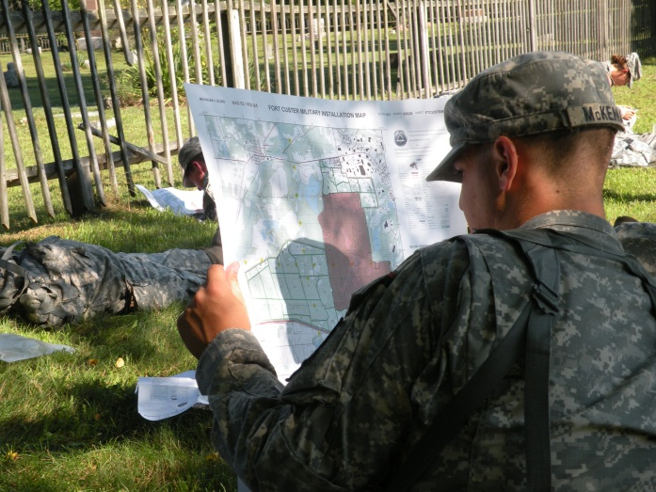
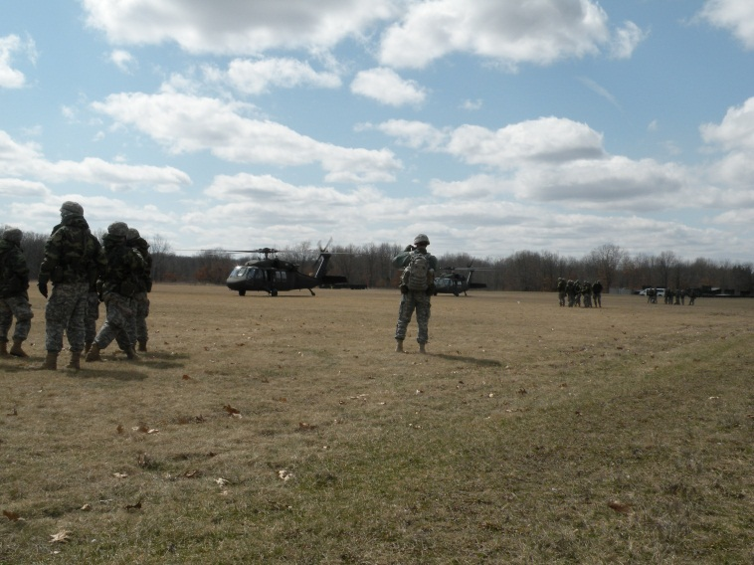
Leadership Lab
Wednesday Evening
Leadership Development
Land Navigation
Marksmanship Training
Squad Battle Drills
Water Survival Training

Slide 7
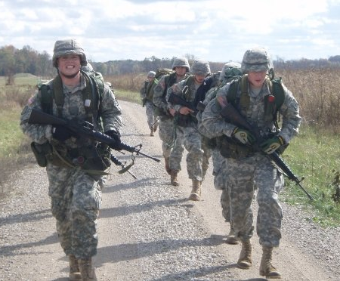
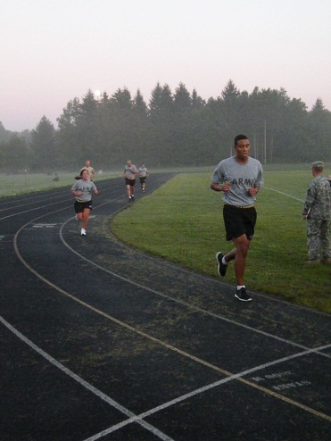
Physical Training (2 per week)
Ruck(backpack)
marches
Physical Fitness Test
Road Marches
Platoon PT
Battalion Runs
Ability Group Runs
Tri-Mil Run
Cross fit program
Basketball/Ultimate Frisbee
Physical Fitness Test

Slide 8
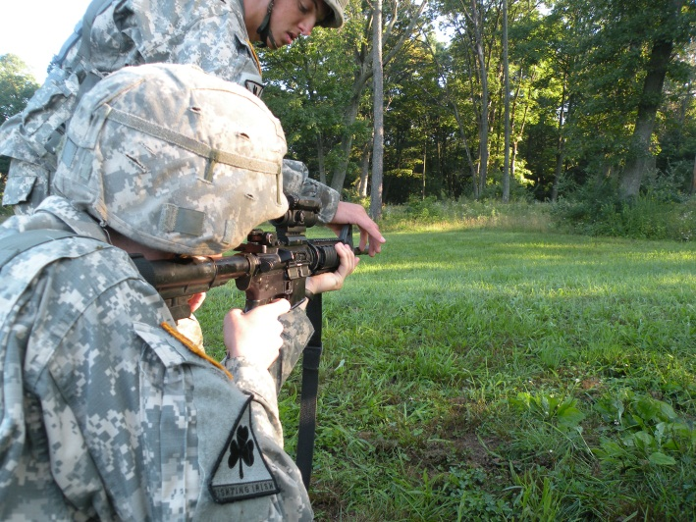
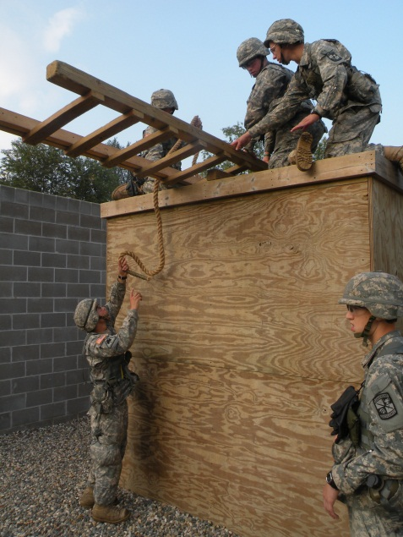
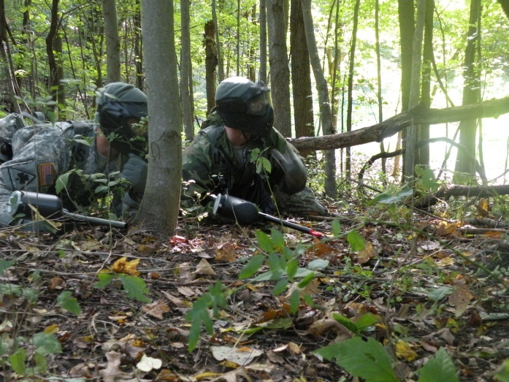
Field Training Exercise (one per semester)
Confidence Course
Land Navigation
Basic Rifle Training
Rappelling
Road Marches
Field Leaders Reaction Course
Squad Tactical Training
Patrolling
Leadership Development

Slide 9
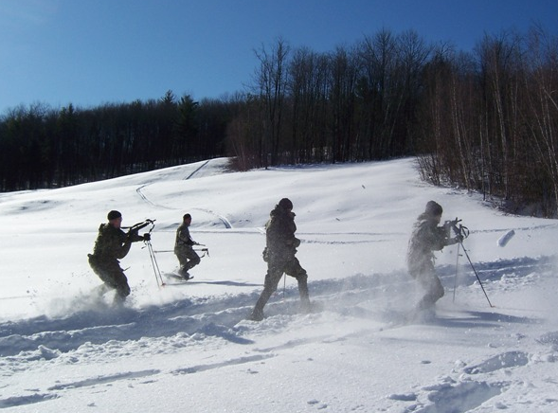
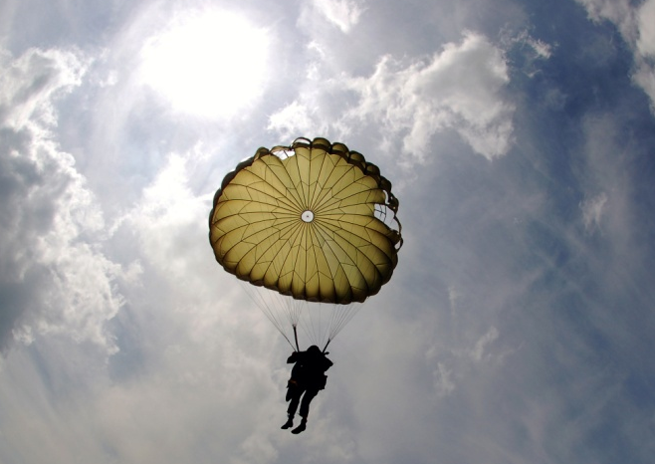
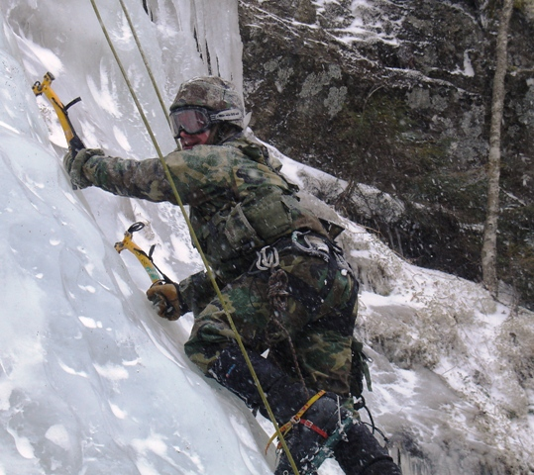
Army Schools - Summer Training
Airborne School
Air Assault School
Mountain Warfare School
Northern Warfare School
CTLT (3 week internships with Active Army)
Leadership Development Course

Slide 10
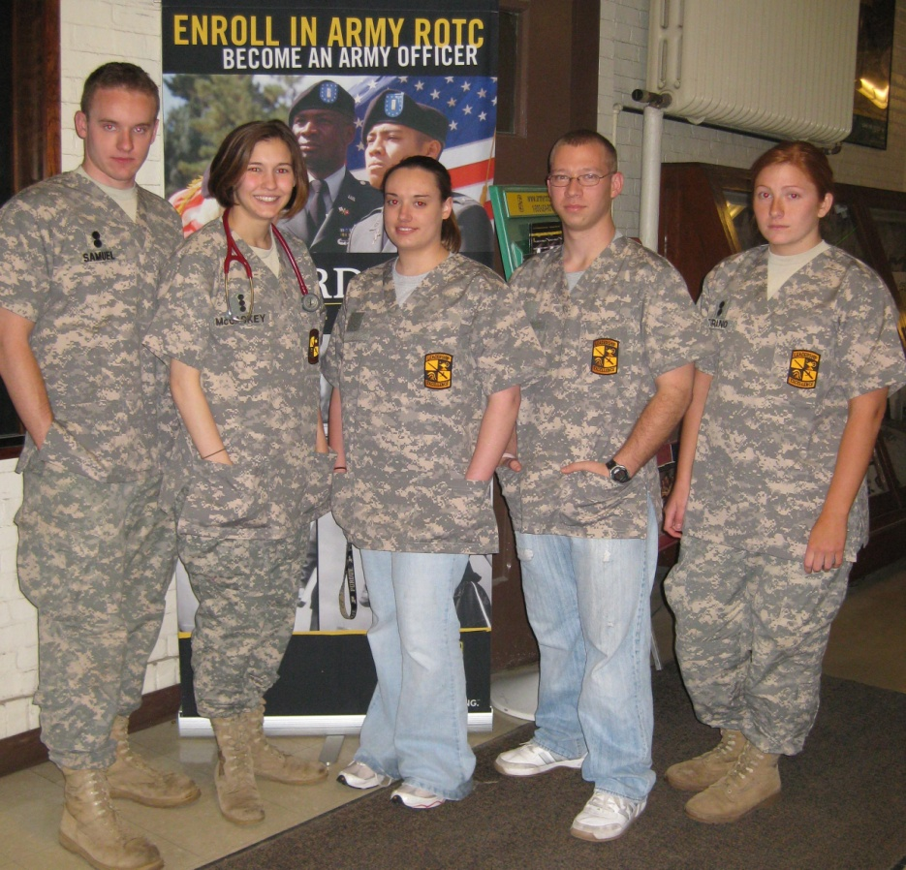
Nursing
Unlimited Scholarships to Qualified Nursing Students
Receive annual book allowance ($1200) each Fall
NCLEX practice course and exam covered
Mentored by a Senior Army Nurse
Summer training after Warrior Forge at a Military Hospital
Progression Awards
Stethoscope
PDA (palm pilot)

Slide 11
What is the SMP?
The Simultaneous Membership Program is:
A 2-4 year paid military internship you complete while attending school
An early chance for you to lead troops
Opportunity to set yourself ahead of your peers
A great way for you to decide which job in the Army is right for you

Slide 12
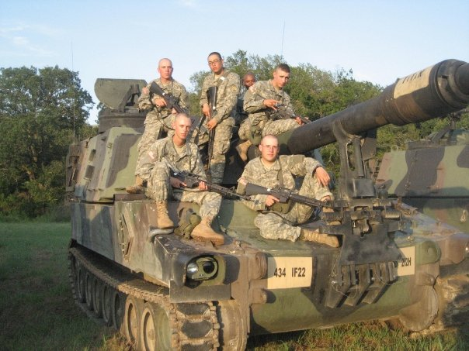
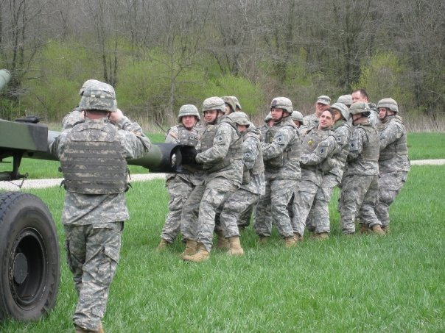
Drill Weekends/2 Week Annual Training
Drill with a variety of different units
Serve in an active leadership role
Choose which unit you would like to drill with

Slide 13
SMP Financial Benefits
National Guard Financial Benefits
100% tuition (Indiana residents only)
Potential enlistment bonus
Monthly GI Bill $333.00 plus kicker of $350.00
Monthly ROTC stipend $350/So, $450/Jr, $500/Sr
Sergeant pay-$275.00 monthly
Guaranteed Reserve Forces Duty / Dedicated Guard Scholarships cover room and board ($10,000/yr)
United States Army Reserve
$4500/yr tuition assistance
Monthly ROTC stipend $350-$500
Guaranteed Reserve Forces Duty Scholarships

Slide 14
Additional ROTC Scholarship Options
Guaranteed Reserve Forces Duty (GRFD)
Dedicated Army National Guard
(DED-ARNG)
Guard or Reserve Forces
2 Years Only (1-4 Semesters)
Must SMP (Guard or USAR)
Guard or Reserve after commission
Limited Number
Can use with any GI Bill
Pays tuition or Pays Room & Board (R&B $10,000 max for off campus)
Only MJC cadets may Revoke
Should apply before contracting, but not necessary
Must sustain a 2.5 GPA
Must be academically aligned
Guard Only
2, 2 ½, 3 years (1-6 Semesters)
Must SMP with Guard only
Guard only after commission
Limited only by Funding
Can not use with chapter 1606/1607 MGIB
Pays tuition or Pays Room & Board (R&B $10,000 max for off campus)
Non-revocable
Should apply before contracting, but not necessary
Must sustain a 2.5 GPA
Must be academically aligned

Slide 15
Army National Guard VS Army Reserves
Army National Guard Benefits
100% instate-tuition
MGIB
MGIB-Kicker
ROTC Stipend
Drill Pay
Over 200 units to choose from
NON deployable while a cadet
Combat Arms
INARNG Cadre at University
SMP Drilling Policy
Army Reserves Benefits
$4500/yr tuition
MGIB
MGIB-Kicker
ROTC Stipend
Drill Pay

Slide 16
Prior Service Option (for current members of the National Guard/Reserves)
ROTC Prior Service Timeline
Freshman
Sophomore
Junior
Senior
Drill with NG Unit
Commission upon Graduation
Attend LDAC
(4 week Summer Assessment)
Enter program dependent upon Academic Standing
Contract SMP

Slide 17
Split Training Option (for those choosing to attend enlisted basic and advanced training)
ROTC Split Operation Timeline
HS Senior
Freshman
Sophomore
Junior
Senior
Drill with RSD
Drill with University
Drill with Unit of Choice
Commission upon Graduation
Attend Basic
(9 week summer course)
Attend Advanced Summer Training (length dependent upon chosen job)
Contract SMP
Attend LDAC
(Summer)

Slide 18
LTC SMP Option (for those already in college wanting to join their junior year)
ROTC LTC Timeline
Freshman
Sophomore
Junior
Senior
2 Years as Traditional Civilian College Student
Drill with Unit of Choice
Commission upon Graduation
Contract SMP
Attend LTC
(5 week Summer Course)
Attend LDAC
(4 week Summer Assessment)

Slide 19
Progression Cadet Option (for those Cadet who participate the first two year and want to drill with a unit)
Progression Cadet Timeline
Freshman
Sophomore
Junior
Senior
Active Participation for 2 Years as ROTC Cadet
Drill with Unit of Choice
Commission upon Graduation
Contract SMP
Attend LDAC
(4 week Summer Assessment)

Slide 20
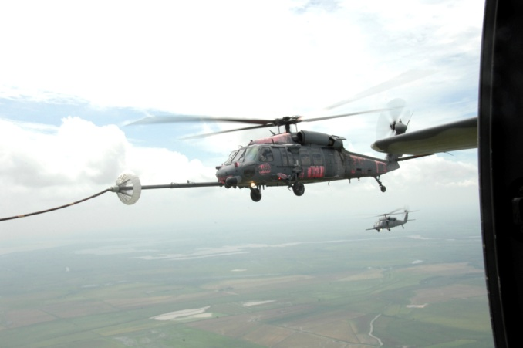
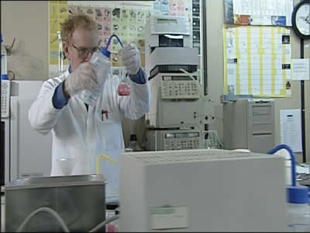
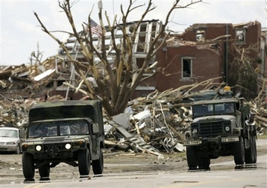
National Guard After College

Slide 21
ARNG Mission
What is the Army National Guard’s Mission?
State Mission:
Governors of each state command the Guard force during peace-time
Can be called into action during local or statewide emergencies
Federal Mission:
Serve locally on security details and federal emergencies deemed by the President of the US.
Serve abroad
Serve as active army support unit in time of war

Slide 22
Questions?
For more information contact Notre Dame’s National Guard Liaison:
CPT Kyle Vonderheide
210 Pasquerilla Center
Notre Dame, IN 46556
(574) 631-4656
1-800-UND-ARMY
kvonderh@nd.edu

